Slide 1
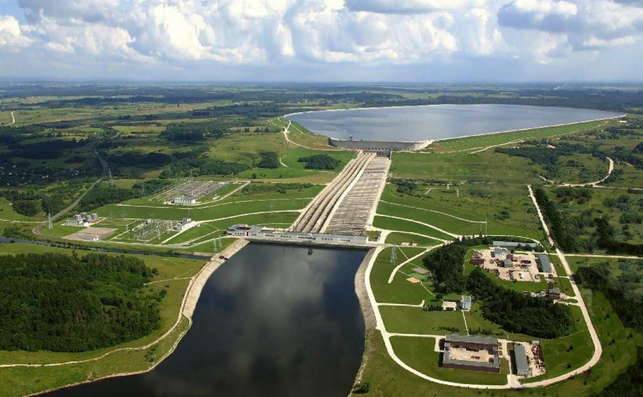
Exelon Project update
Lusha Wang, Tianqi hong, zhi zhou, Balasubramaniam, Karthikeyan
Argonne National Laboratory
Sept 6, 2022

Slide 2
Grid impact update
Co-simulation Environment Setup
Python Environment
Octave environment
OpenDSS
Matpower
Distribution System Analysis
Transmission System Analysis

Slide 3
Grid impact update
Distribution System Analysis API
Solve power flow and get operational conditions in the network, including voltages, load and power flow
Scale load in the system to increase or decrease overall loading condition
Change substation voltage
Change controllable status of each load
Add PVs in the system
Change DER setpoints
Change switch status
Transmission System Analysis API
Run AC power flow and get system operational conditions
Change load condition in the network

Slide 4
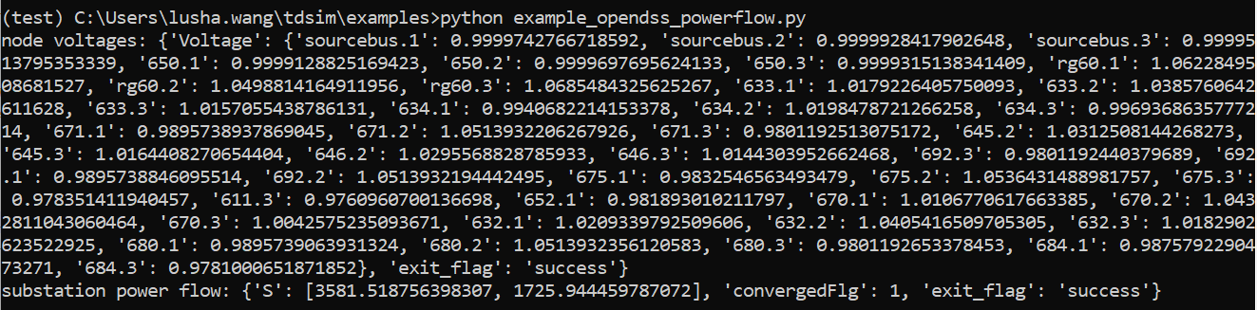
Grid impact update
Snapshot of Distribution Analysis

Slide 5
Proposal
Goal
Develop utility managed smart charging system
Evaluate smart charging impact on distribution operation
Evaluate utilities’ ability to control EV charging based on grid conditions
BP 1
Cybersecurity testing: simulate DR event, develop threat models
Platform for grid services: test DR, test frequency regulation
Smart charging management: collect data, develop smart charging measures
Negotiation and execution with vendors
NO MILESTONE RELATED

Slide 6
Proposal
BP 2
Simulate EV charging demand on grid and evaluate impact
Develop driver-agent model in ATEAM to determine where and when to charge (Yan Zhou)
Translate utility-managed smart charging scenarios into ATEAM inputs (Yan Zhou)
Run simulations in ATEAM for infrastructure and EV adoption evolution under different scenarios (Yan Zhou)
Install utility-owned charging network
Collect data and develop system for future economic impact analysis
Analyze cybersecurity challenges and perform cyber impact analysis
NO MILESTONE RELATED

Slide 7
Proposal
BP 3
Implement smart charge management demonstration
Re-calibrate ATEAM tool with demo results (Yan Zhou)
Collect results from ATEAM
Develop ATEAM-T&D co-simulation tool to analyze grid impact
Analyze economic impact analysis on EVSEs and the grid
Evaluate revenue and operational cost of smart charging management and grid service provision profiles
Assess grid upgrade needs, cost and benefits based on grid and EVSE expansion scenarios
Perform cyber-physical threat model and impact analysis
Adjust tactics to improve grid benefit and driver behavior
MILESTONES:
Co-simulation tool (ATD) validated
Impact analysis completed

Slide 8
Proposal
BP 4
Conduct second year demonstration of smart charge management demonstration.
Analyze grid impact
Perform scenario generation and analysis
Simulate grid impact, evaluate mitigation options under different scenarios
Analyze driver behavior and grid benefits
MILESTONES:
Data preparation demonstrated
EV impacts to the grid quantified

Slide 9
Grid impact analysis update
Done:
Implementing distribution system operation analysis about randomly adding EV
To Do:
Testing adding EV function on IEEE 13 node system in co-simulation environment

Slide 10
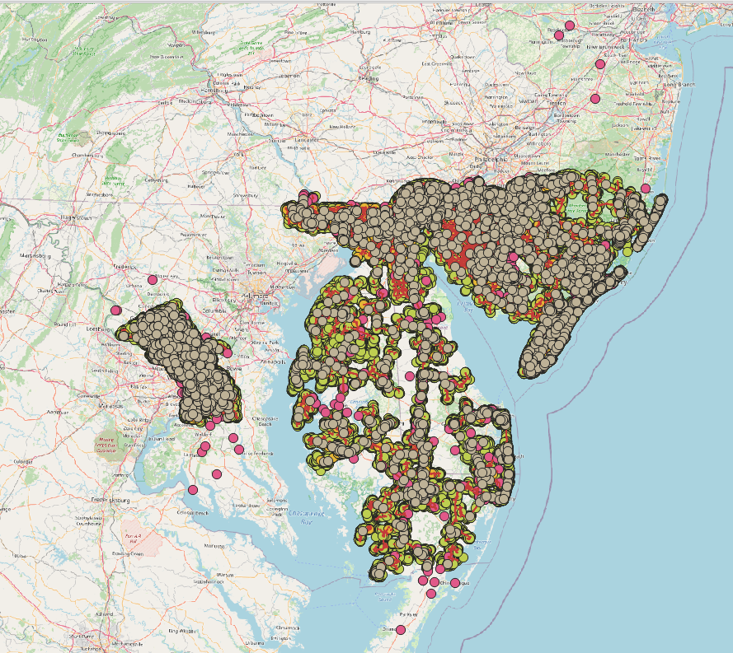
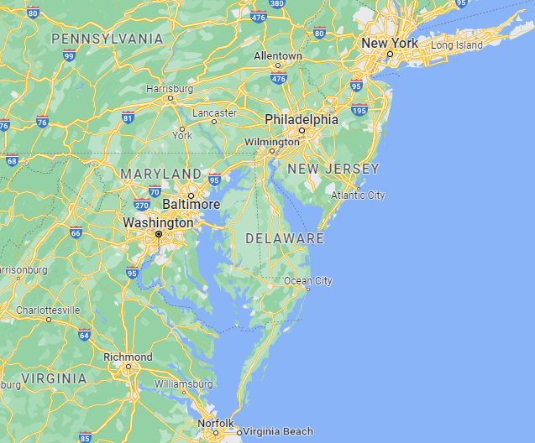
Grid impact analysis update
Done:
Obtained Exelon GIS data for: Maryland, Delaware, New Jersey

Slide 11
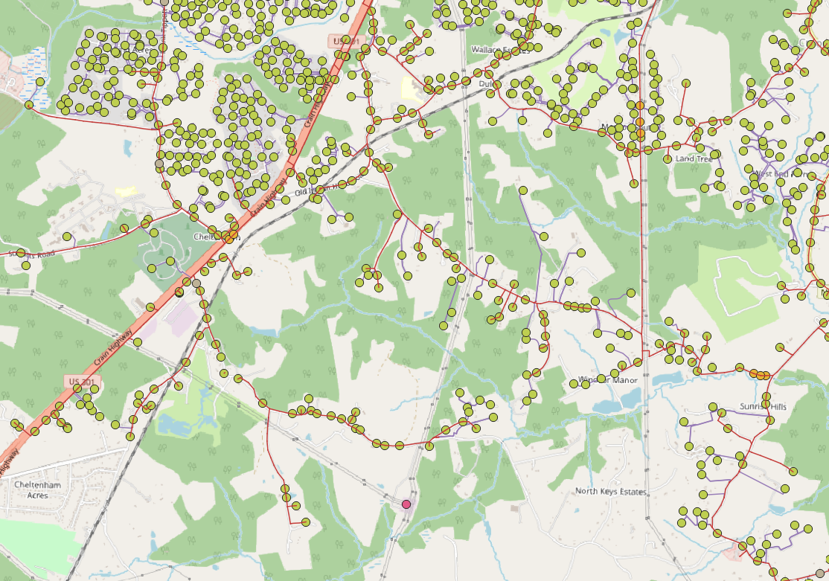
Grid impact analysis update
Done:
Available Information:
Secondary transformer location
Overhead line connection
Underground cable connection
Capacitor bank location
Regulator location
Substation location
Missing information:
Substation connection
Physical parameters (line parameter, load, voltage level, transformer size, device parameter)

Slide 12
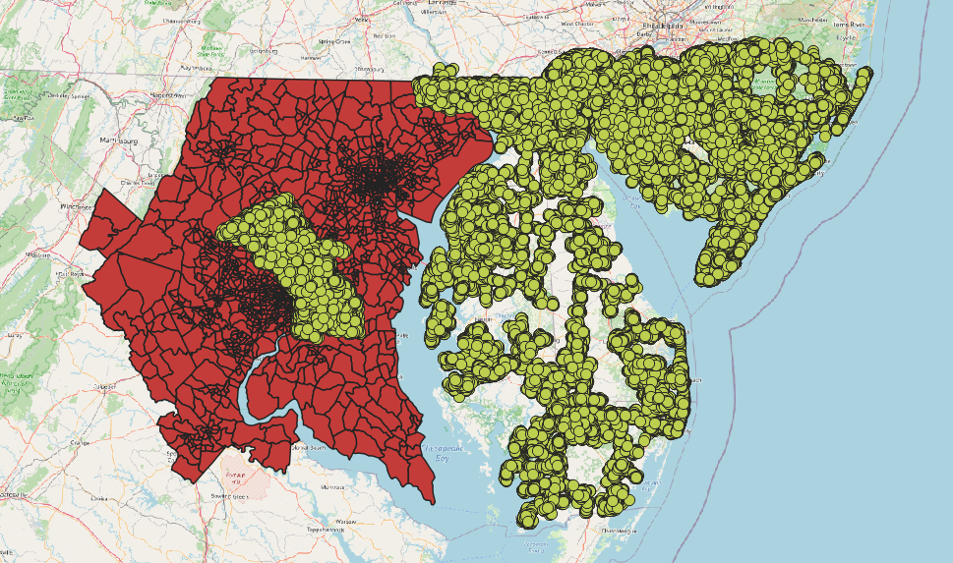
Grid impact analysis update
Exelon GIS data and ATEAM study area comparison
Red area: ATEAM study area
Green area: available Exelon GIS data
We choose MD area as our target study area
Test feeder model
Use available excel files from GIS data
Check with Exelon engineer about data meaning
Coding for selecting information from a specific feeder
Use CYME model from Exelon
Not sure whether they will provide it
Once they provide it, we will work on translating CYME file to OpenDSS file

Slide 13
Grid impact analysis update
Study level
Feeder level analysis using Exelon data (check with Exelon)
T&D example with IEEE 8500 nodes system
Economic generic data preparation
Substation expansion cost
Charging station building cost (from Joann)
Charger cost (from Joann)
Line expansion cost
Wholesale electricity price
Utility electricity price (NREL database)
Study scenarios discussion
Peak day

Slide 14
Grid impact analysis update
BEG CYME Data
Received data on Tuesday, roughly went through the data
304 tables in total, around 100 tables with value
Which area covered? Different from previous PHI GIS data? GIS data covers DC, part of Maryland, Virginia, New Jersey, Delaware
We do not have CYME license. Need to figure out how to work with the data
BEG CYME Data Comparison with Data Request
Distribution feeder data requested are available in the CYME data
Customer load available in the CYME data
Need more time to check whether all parameters are complete
Control logic, DER data, load profile not available from Exelon
Economic information not provided yet, but can use generic data as substitute

Slide 15
Grid impact analysis update
Summary of BGE CYME Data
1758 feeders and 1684 feeder dependencies
180 sources and 5680 equivalent source
1002989 nodes, 5003282 intermediate point, 14710 node inter, 1898 head node
785806 customer load, 207808 load, 5673 equivalent load
250854 overhead line, 257105 underground line, 207480 transformer, 258660 switch
5397 shunt capacitor, 80 regulator, 707 load tap changer, 80 auto tap changer
148264 fuse, 3022 breaker, 4184 recloser, 1685 sectionalizer
1027156 section, 226510 section UDD, 1344761 section device
6988 structure, 20620 structure connection
216882 device UDD, 3434 meter

Slide 16
Grid impact analysis update
Some questions about BGE CYME Data
Feeder number and source number not matching. Some feeders with multiple sources.
Feeder dependencies meaning.
Node location converted to latitude/longitude: X=474914.384 Y=195182.113
Technical details about data meaning and correlation among different tables.
CYMNETWORKDEPENDENCIES
NetworkId1 | NetworkId2 | Child
13003 | CENTER_13KV | 1
13004 | CENTER_13KV | 1

Slide 17
Grid impact analysis update
Future plan
Determine study area and study level, feeder level or large scale network
Need more time to figure out CYME data. Good if we can have technical detail support from Exelon experts.
Using python to read CYME data and work with data
Plot node locations to understand where the networks are in the map
Filter feeder and extract all related information, select a feeder of interest
Convert CYME data into Gridlabd/OpenDSS format depending on what tools we can find. Might take several steps to finally get OpenDSS model
Writing codes for converting data to accommodate existing data information
Validate OpenDSS model power flow
Repeat for two or three feeders

Slide 18
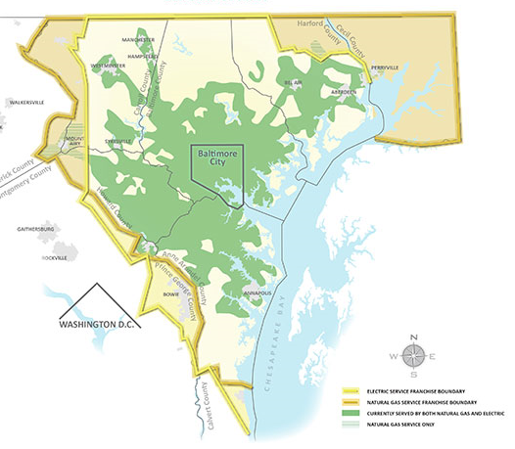
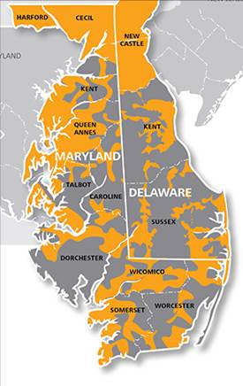
Data collection update
PHI Data
BGE Data
Delmarva Data

Slide 19
overall plan
Step 1:Data Collection and Network Modeling
Step 2: ATEAM Coupling
PHI and BGE Cyme Network
ATEAM Charing Schedule
PHI and BGE OpenDSS Network
Charging Schedule Mapping and Disaggregation to Feeder Level
Typical Feeders
Power Flow Analysis in Feeder Level
Economic Analysis in Feeder Level
T&D Co-simulation
Step 3: Grid Impact Physical, Economic, T&D Analysis

Slide 20
Data collection and network modeling
Step 1:Data Collection and Network Modeling
Collect Exelon network data: PHI, BGE, Delmarva
Determine data source to use: PHI, BGE data which covers Baltimore and DC to align with ATEAM study area
Collect PHI and BGE data in cyme txt format: we have 2 BGE feeders in cyme txt
Develop multi-source Cyme(txt)-OpenDSS conversion tool
Determine typical feeders in PHI and BGE network
Convert selected feeders to OpenDSS format
Generic Data Collection: cost, electricity prices
No milestone for CEEESA in BP2
PHI and BGE Cyme Network
PHI and BGE OpenDSS Network
Typical Feeders
Cyme(txt)-OpenDSS Conversion Tool
Why we need it: to accommodate customized models in analysis, conduct different types of analysis with more flexibility, and to be integrated in T&D co-simulation tool
Challenges: unclear about physical definition, attributes and how to separate different feeders
Working on tool development to translate multiple feeders with multiple sources (not supported in current version of the tool)
Doable, but would take a couple of months
Feeder Selection
Needs more discussion about which feeders to select as typical feeders in analysis

Slide 21
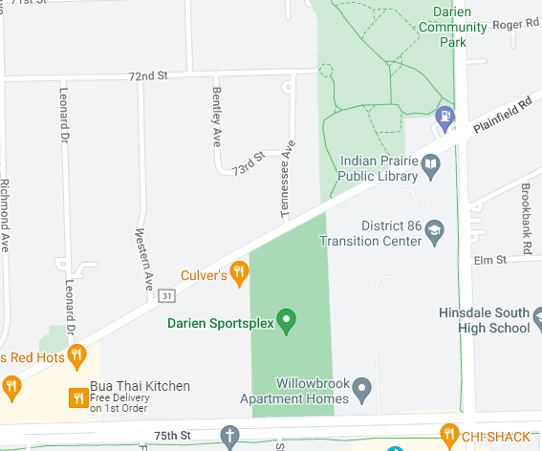
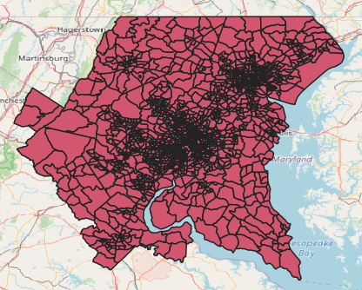
Ateam coupling
Collect ATEAM results in selected feeder area
Disaggregate ATEAM result to nodes in the feeder level
Model EVCS in the selected feeders with location, capacity, EVSE type, and charging profile
We do not have ATEAM example result now
Step 2: ATEAM Coupling
ATEAM Charing Schedule
Charging Schedule Mapping and Disaggregation to Feeder Level
Node
EVCS
Line
Substation
Impedance

Slide 22
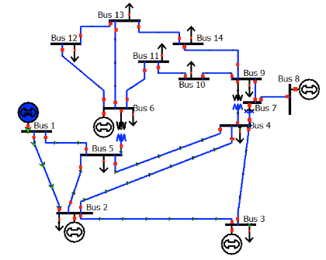
Grid impact analysis
Step 3: Grid Impact Physical, Economic, T&D Analysis
Power Flow Analysis
Run power flow on selected feeders with EVCS charging profiles from ATEAM
Check voltage profiles, network losses, line congestion, transformer overload, overall loading condition, peak load in the network
Conduct time series power flow with different load profiles, different EV charging profiles and different EV penetration level
Power Flow Analysis in Feeder Level
Economic Analysis in Feeder Level
T&D Co-simulation
T&D Co-simulation Analysis
Using IEEE standard transmission network and BGE distribution feeders in co-simulation platform
Economic Analysis
Evaluate revenue and operational cost of smart charging management and grid service provision profiles
Assess grid upgrade needs, cost and benefits based on grid and EVSE expansion scenarios
Connected to

Slide 23
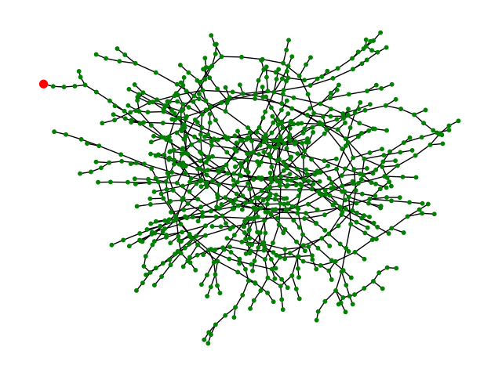
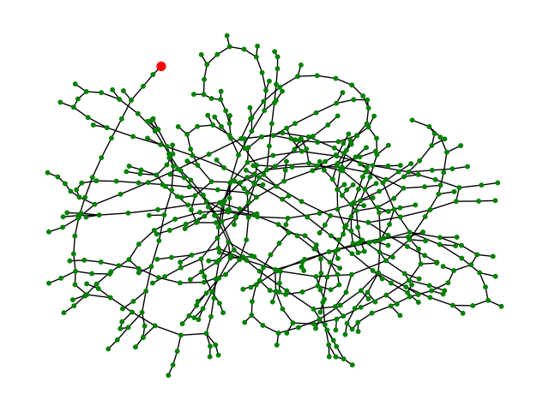
Data collection and network modeling
Cyme(txt)-OpenDSS Conversion Tool Progress
New Capabilities
Separated information for different feeders
Converted multiple feeders with multiple sources from Cyme to OpenDSS at one time
Outcomes for converted two feeders
Feeder 7732 with 871 nodes, Feeder 7773 with 607 nodes
SOURCE_7732
SOURCE_7773

Slide 24
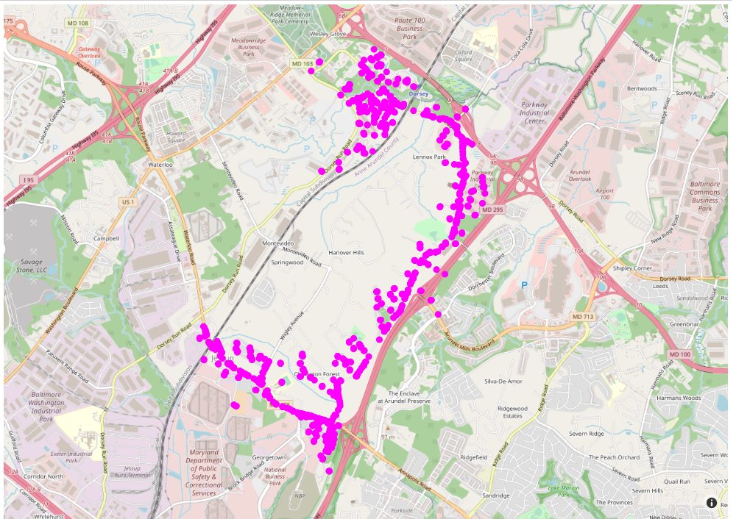
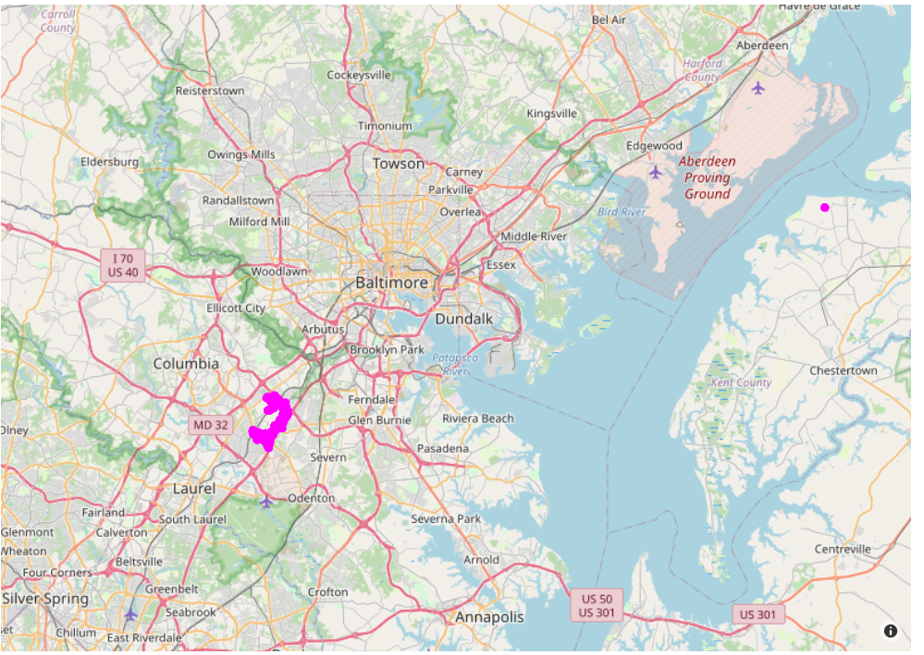
Data collection and network modeling
Feeder 7732
Outliers

Slide 25
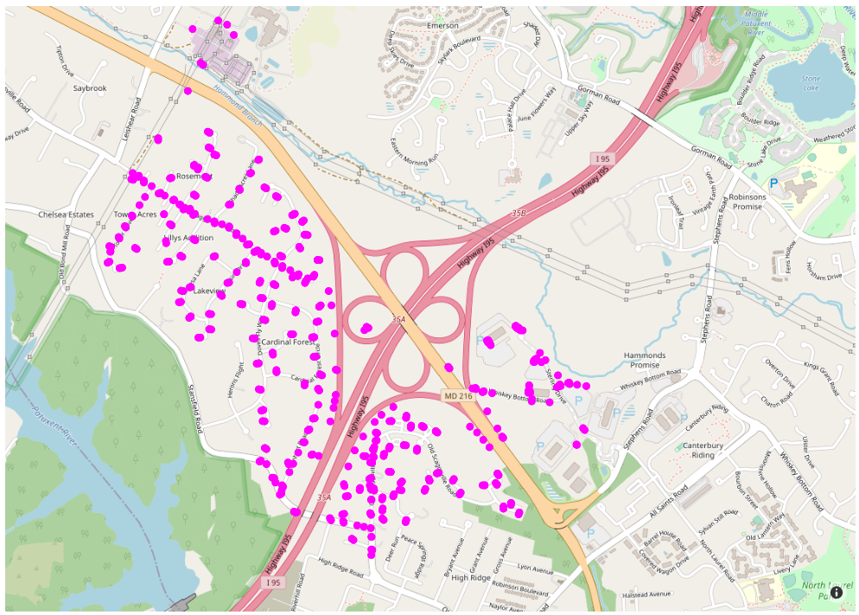
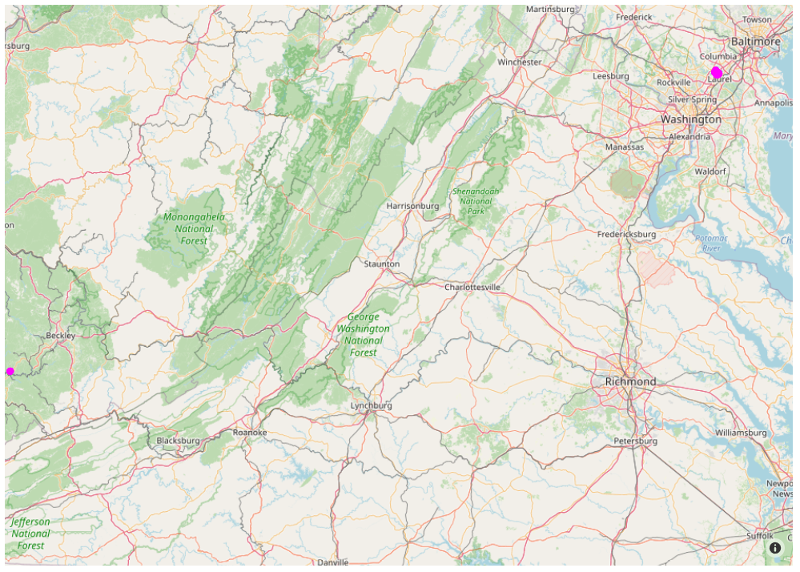
Data collection and network modeling
Feeder 7773
Outliers

Slide 26
Data collection and network modeling
Cyme(txt)-OpenDSS Conversion Tool Progress
Questions to Exelon
CRS for these two feeders?
We assume it to be Maryland EPSG:2248
Outlier nodes which are far from Maryland
source_7732, source_7732-1, 31109103031_5517425, 31109103032_5517430,5517698-1
source_7773, source_7773-1, 4932737, 31114303147, 31114303132, tiepoint_31114303153
Power flow solutions of the two BGE feeders
PHI Cyme data not received

Slide 27
Data collection and network modeling
Cyme(txt)-OpenDSS Conversion Tool Progress
Issues in the converted two feeders (working on developing and improving conversion tool)
Series lines with duplicate names
Node name with “.” does not satisfy OpenDSS name rules
Wrong phase connection for load: 2-phase load on one phase, 6-phase load
Networks contain loops: check whether it is due to normal-open switches
Networks contain duplicate line: check whether it is due to normal-open switches
Next Step
Check three/two/single phase line/transformer/load information
Solve above issues in conversion tool and check for any other issues in OpenDSS file
Plot these two feeders on map
Need to check with Exelon which crs they are using for coordinates
Check outlier nodes
Check power flow results with BGE
Need to ask BGE to provide power flow results for these two feeders

Slide 28
Data collection and network modeling
ATEAM Coordination
Output from ATEAM
Census tract level new charger number and type of each charger
Known existing public charging station's location
Unknown about home charger location
Unknown about new charger location
Daily profile of each charger: not available now, Nazib will work on this
ATEAM-Power Feeder Mapping
Connect existing charging station to feeders
Randomly assign new chargers in each census tract to feeder nodes
Select typical profiles if not available from ATEAM
Run simulations under different scenario

Slide 29
Data collection and network modeling
Feeder Selection Criteria
Align in the ATEAM study area (see attached map). Maybe choose some from the PHI network and some from the BGE network. The map is also available here: https://www.google.com/maps/d/u/0/edit?mid=1v6F3lLqyTdigKkP04ogTr_p4uA5iKYY&usp=sharing
Choose feeders with different voltage levels
Choose feeders in different areas type (for example, choose some from urban areas, semi-urban areas, or rural areas)
Choose feeders with different load types (for example, choose some mainly with commercial load, some mainly with residential load or industrial load)
Choose some feeders in a heavy populated area and some from not so heavy populated area
Choose some feeders with large service areas and some with small service areas
Choose feeders with and without devices (regulator, switch, recloser, transformer)
Any feeders that Exelon is interested in, regardless of the above criteria

